Slide 1
Program Slicing
Name : Md Mehedi Hasan
Supervisor : Abdus Sattar

Slide 2
What is Program Slicing ?
Finding all statements in a program that are directly or indirectly affected by a certain variable.
A methodology for omitting program modules that are
irrelevant to a particular computation process based on a criterion known as the slicing criterion.

Slide 3
Motivation
Debugging
Cohesion Measurement
Comprehension
Maintenance and Re-engineering

Slide 4
Some Basic Concepts
Slicing Criterion :
The pair <s,v> is known as Slicing Criterion where ‘s’ is a program point of interest and ‘v’ is a variable we will use for slicing the program.

Slide 5
Some Basic Concepts
Types of program slicing :
Depending on the run-time environment, it can be :
Static slicing
Dynamic slicing
Depending on traversal, it can be
Backward slicing
Forward slicing

Slide 6
Objective of my work
I am using static forward slicing method in this purpose.
Input :
A source code of C / C++ program.
Slicing criterion <s,v>

Slide 7
Objective of my work
Process :
Reading the input file,
Finding variables & then statements dependent on slicing criterion,
Writing these statements into another file.
OutPut :
A sliced compilable source code ( C/C++ ) of the input file.

Slide 8
What I have done so far…
Background study :
Basic concepts & methods of slicing program (Static , dynamic , forward , backward)
Code : (Still working & need to be improved)
Github link : https://github.com/Mehedi-909/SPL-1

Slide 9
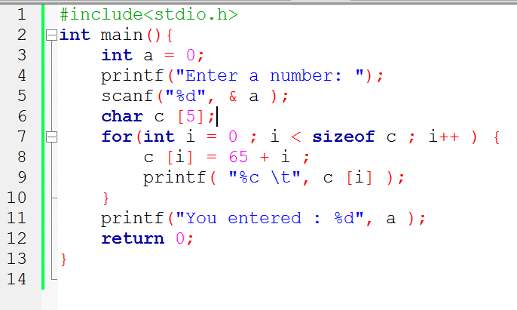
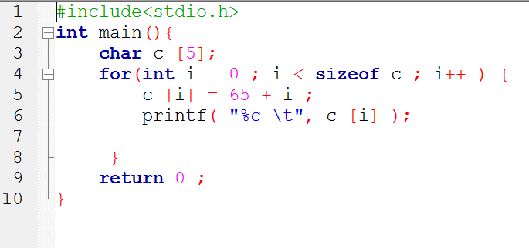
A simple input file & it’s slice slicing criterion <6,c>

Slide 10
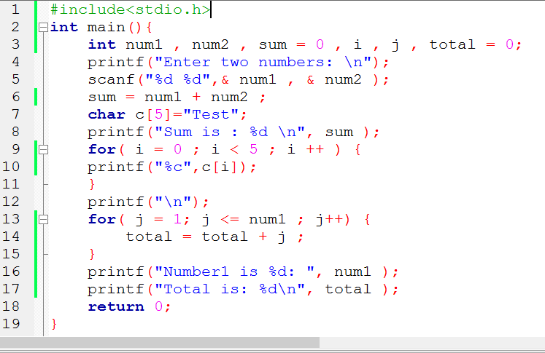
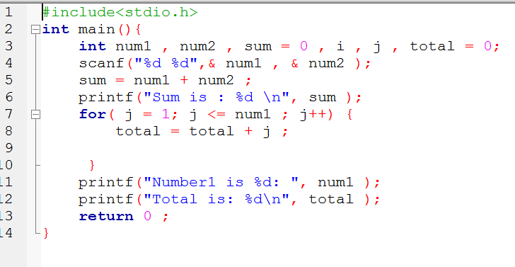
Another example Slicing criterion <3,num1>

Slide 11
References
https://en.wikipedia.org/wiki/Program_slicing
http://www0.cs.ucl.ac.uk/staff/M.Harman/exe1.html
https://www.cs.purdue.edu/homes/xyzhang/spring07/590F-slicing.pdf
https://www.cc.gatech.edu/~harrold/6340/cs6340_fall2009/Slides/BasicAnalysis6.pdf
https://www.cs.drexel.edu/~spiros/teaching/CS576/slides/5.slicing.pdf

Slide 12
Thank you for your kind observation
& co-operation.

